Slide 1


HACKWAVE 2024
Smart Grid Optimization: Integrating Renewable Energy for Sustainable Power Systems
A.P Shah Institute of Technology
Team Member 1 (Leader) : Priyanshu Agarkar
Team Member 2 : Anushree Salunke
Team Member 3 : Mrunal Misale
Team Member 4 : Suyash Bagwe

Slide 2
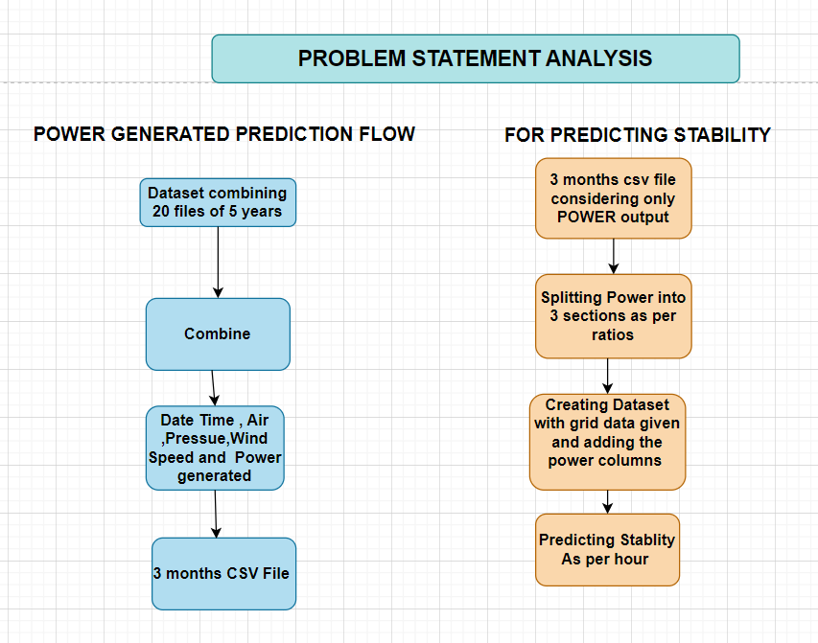

Slide 3
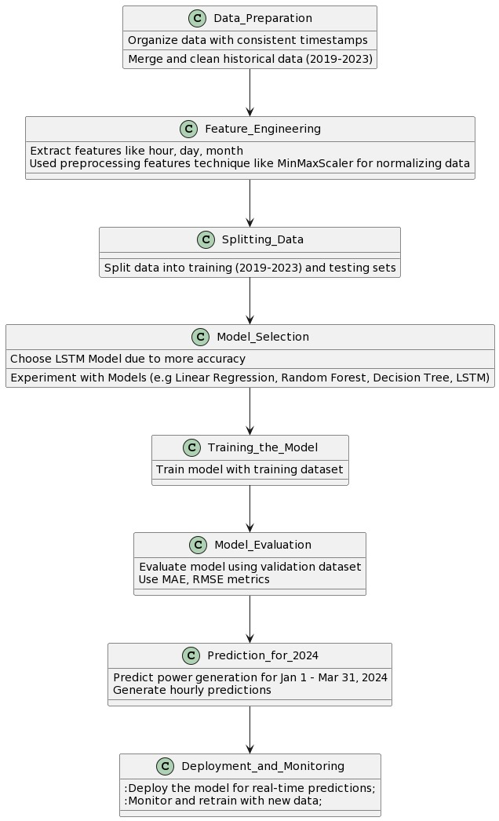
OUR APPROACHES
PART1
PART2

Slide 4
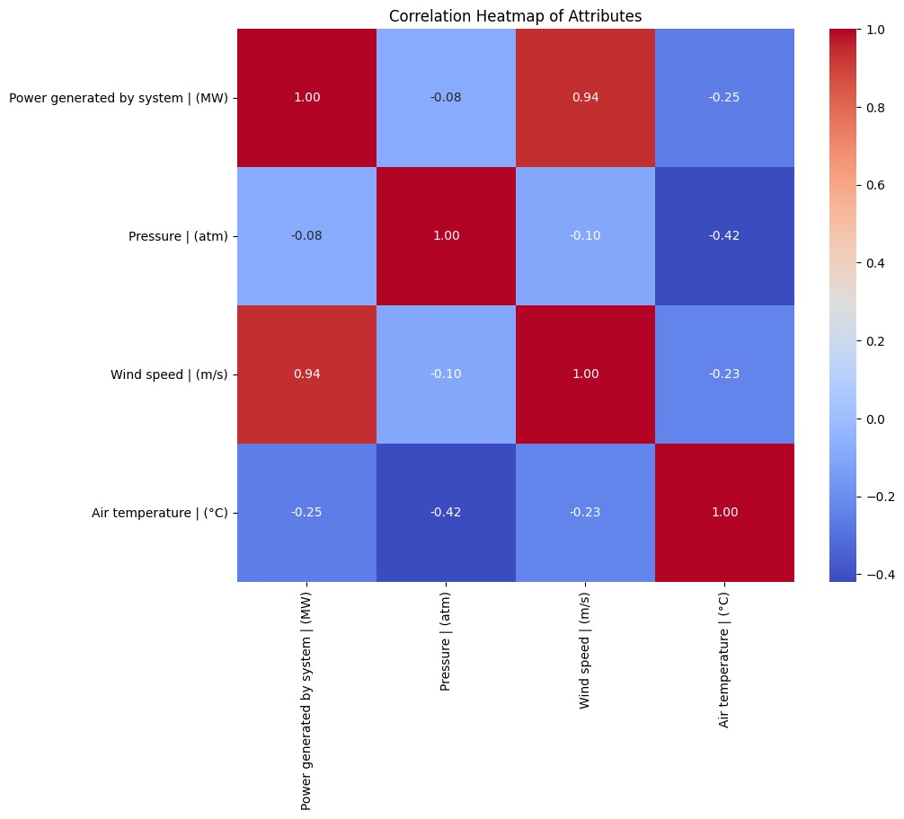
EXPLORATORY DATA ANALYSIS

Slide 5
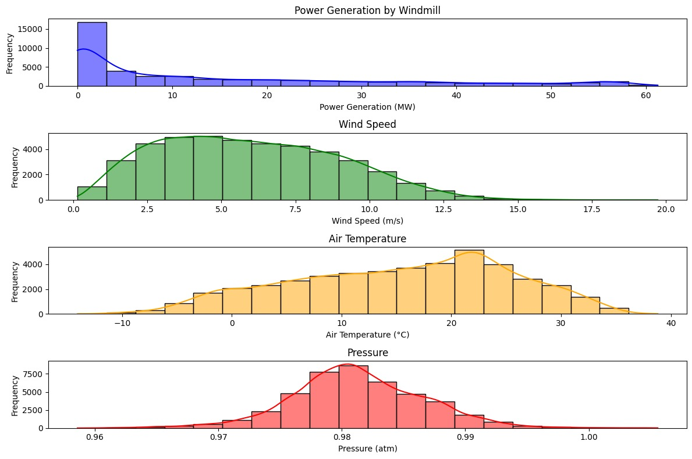

Slide 6
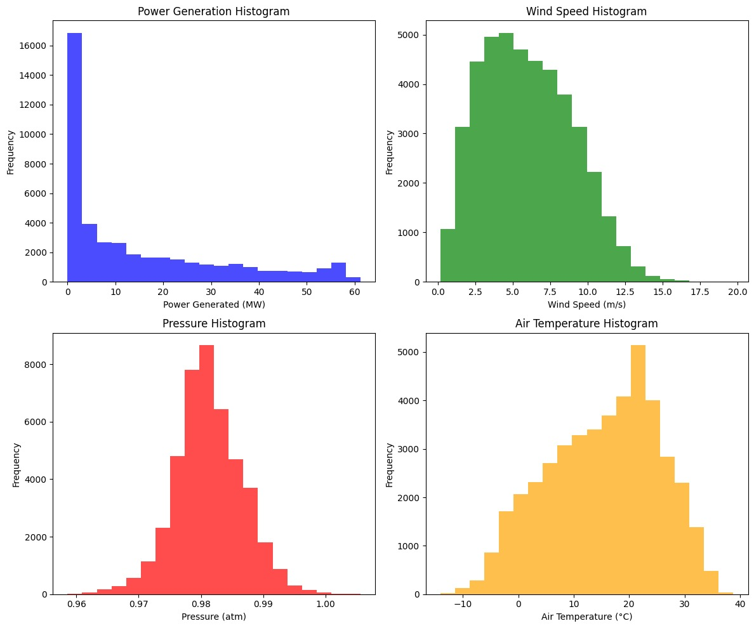

Slide 7
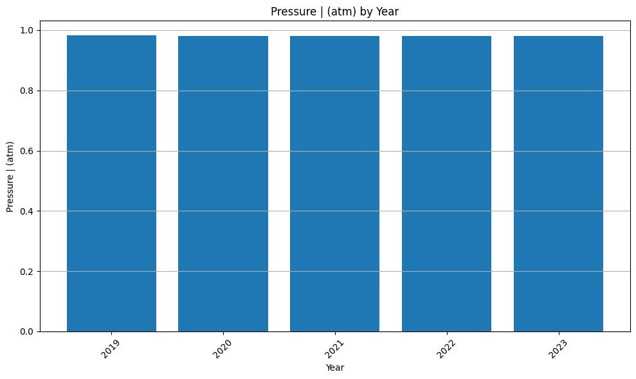
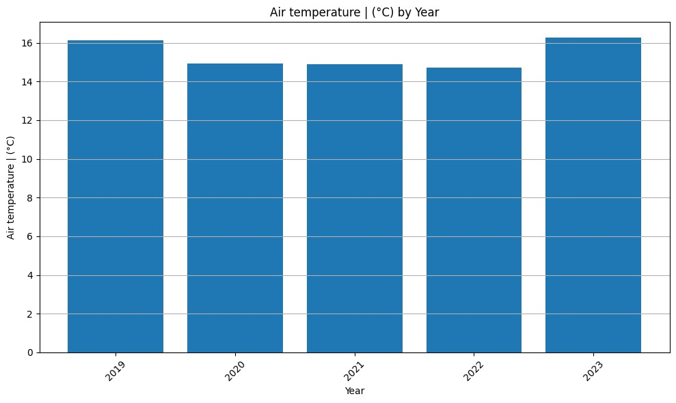
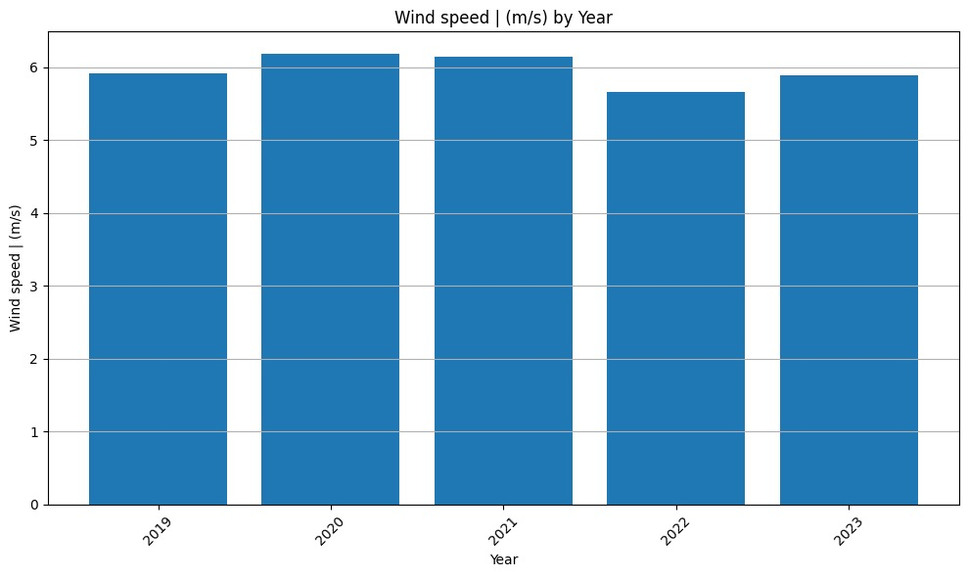
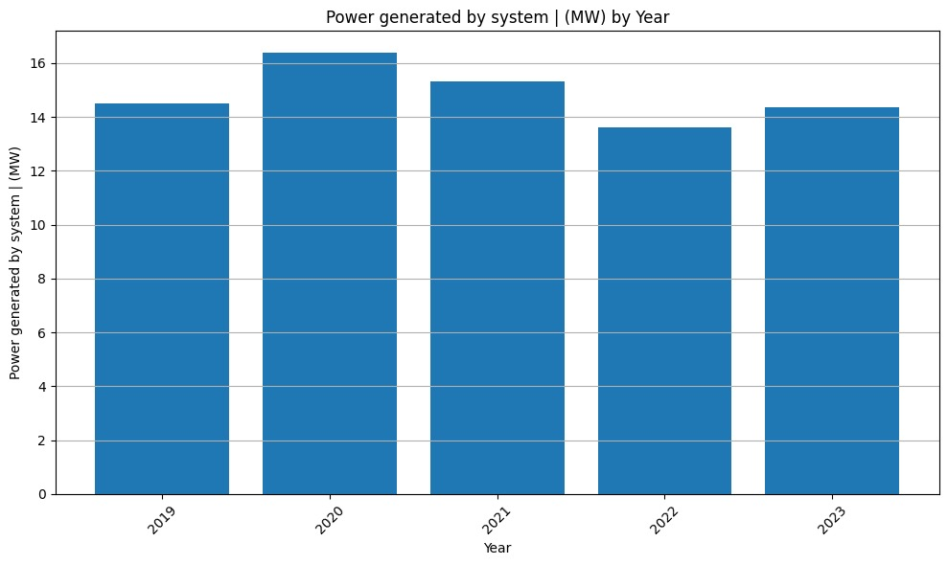

Slide 8
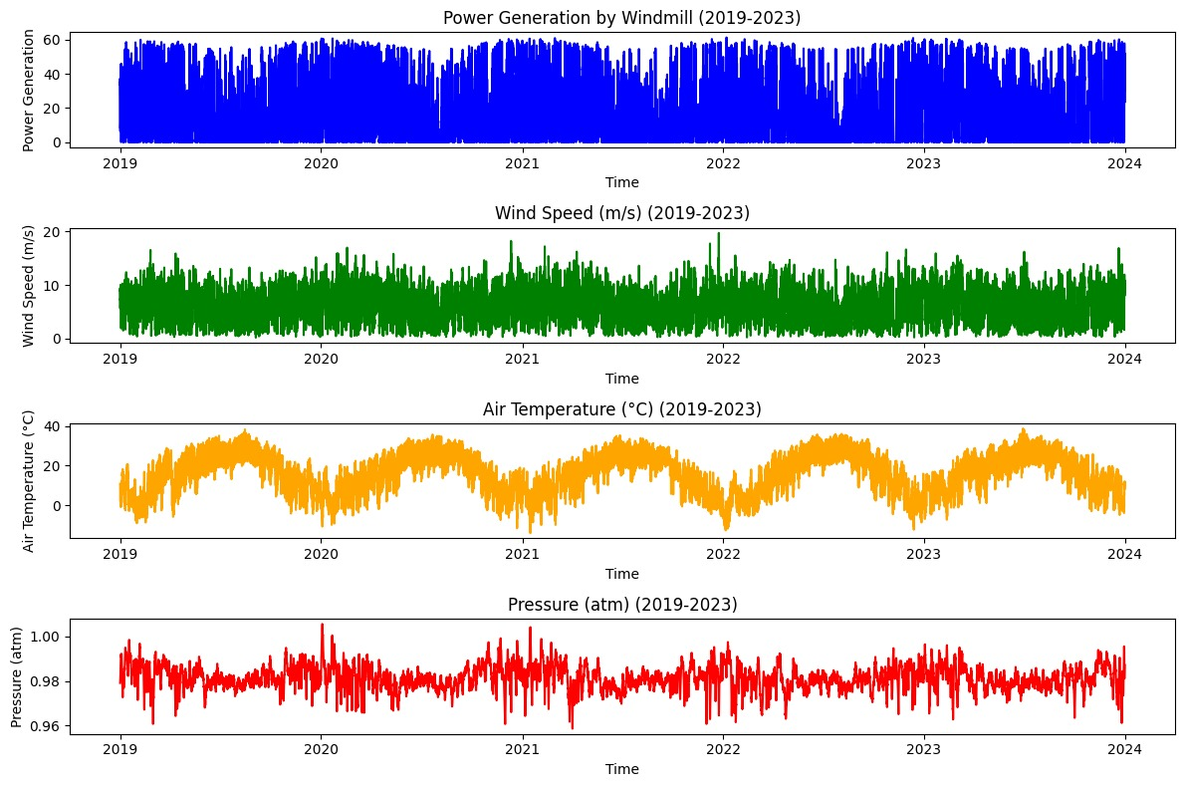

Slide 9

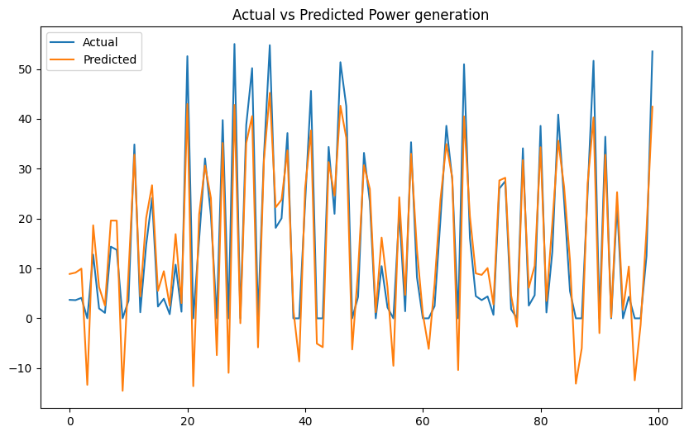
COMPARATIVE STUDY OF MODELS FOR POWER PREDICTION
Linear Regression Graph.

Slide 10
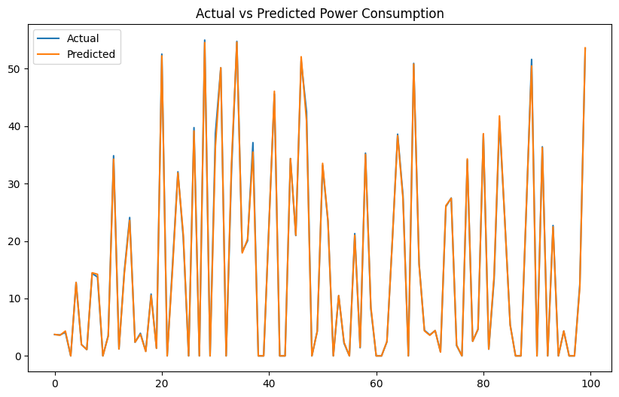
COMPARATIVE STUDY OF MODELS FOR POWER PREDICTION
Decision Tree Graph

Slide 11
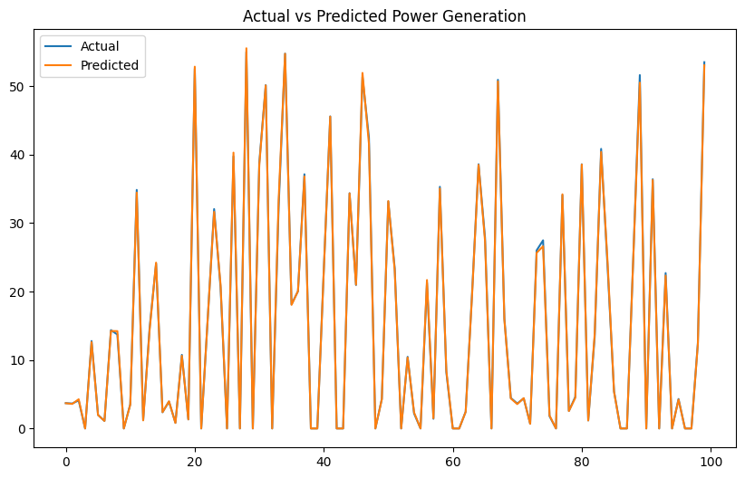
COMPARATIVE STUDY OF MODELS FOR POWER PREDICTION
Random Forest Regressor Graph .

Slide 12

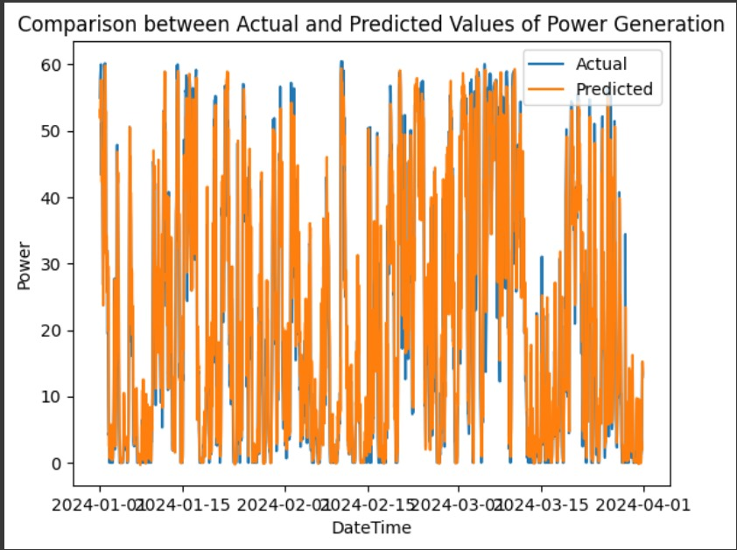
COMPARATIVE STUDY OF MODELS FOR POWER PREDICTION
LSTM Graph.

Slide 13
COMPARATIVE STUDY OF MODELS FOR POWER GENERATION
MODELS | RMSE VALUES
Linear Regression Graph. | 5.695638528830947
Decision Tree Graph | 0.4504704414153667
Random Forest Regressor Graph | 0.29105746848897385
LSTM Graph. | 0.06843911440975985

Slide 14
COMPARATIVE STUDY OF MODELS FOR STABILITY CLASSIFICATION
TRAINING Values
 | Precision | Recall | F1 - Score | Accuracy
Logistic Regression | 0.70 | 0.66 | 0.67 | 0.7174
SVM | 0.70 | 0.66 | 0.72 | 0.7174
KNN | 0.50 | 0.50 | 0.57 | 0.5728
Naive Bayes | 0.70 | 0.65 | 0.66 | 0.7166
TESTING Values
 | Precision | Recall | F1 - Score | Accuracy
Logistic Regression | 0.70 | 0.65 | 0.65 | 0.7116
KNN | 0.44 | 0.46 | 0.54 | 0.5442
SVM | 0.67 | 0.62 | 0.69 | 0.6859
Naïve Bayes | 0.68 | 0.69 | 0.67 | 0.6935

Slide 15
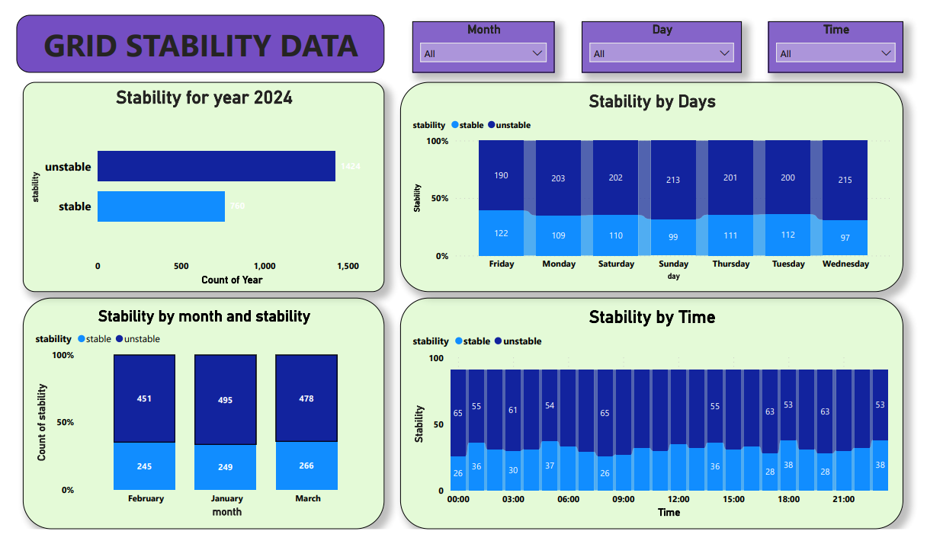
Report And Visualization

Slide 16
Business Insight
1. Significant grid instability observed from January to March 2024 highlights the need for proactive measures.
2. Imbalances in power distribution, price fluctuations, and erratic consumption patterns contribute to instability.
3. Sustainable solutions:
i) Enhance monitoring systems for real-time grid performance tracking.
ii) Optimize power distribution strategies to ensure balanced loads.
iii) Implement stabilization mechanisms like demand response programs and renewable energy integration.
4. Sustainability:
i)Foster stakeholder collaboration for comprehensive policy development.
ii)Invest in infrastructure upgrades and grid modernization.
iii)Promote transparency and accountability in the energy market.
iv) Support research in renewable energy technologies and energy storage solutions.

Slide 17
CONCLUSION
The data was first combined, and then MinMaxScaler was used for preprocessing. After that, the model was trained using different methods, including random forest, decision tree, linear regression, and LSTM, with LSTM turning out to be the most accurate. LSTM was utilized to generate predictions for the first three months of 2024, and the resulting CSV file contained the aggregated grid data. Using techniques like KNN, SVM, Logistic regression, and Naive Bayes, this dataset was used to classify grid stability; logistic regression being the approach of choice. The results were shown via a Power BI dashboard, which showed that the grid was unstable most of the time.

Slide 18

THANKYOU !

